Slide 1
18CSE345T IoT Architecture And Protocols
Unit 3

Slide 2
SYLLABUS
Introduction to RFID, Introduction to NFC, WSN(Large topic), Narrow band IoT (NbIOT), WiFi, PLC Communication Protocols : A comparison, Popular radio protocols and its security drawbacks, 802.15.4 in depth, Network Layer Protocols- Introduction, IPv4, IPv6, 6LoWPAN in depth, 6TiSCH, ND, DHCP, ICMP, RPL, CORPL, CARP

Slide 3
Introduction to RFID (Radio Frequency IDentification)
RFID (Radio Frequency Identification) is a technology that enables the electronic and wireless labelling and identification of objects, humans and animals.
An alternative to Barcode.
Invented in 1948 by Harry Stockman.
COMPONENTS
• Tag (Transponder) – Chip – Antenna
• Reader (Interrogator) – RF Module (Transmitter and Receiver) – Antenna
• Host Computer – Middleware
Tags ( Chip + Antenna). -Tag types -Active. –Passive
Means by which transponder is powered
• Data carrying options
• Data read rates
• Physical forms
• Costs

Slide 4
Introduction to RFID (Radio Frequency IDentification)
Interrogator ( Antenna + Reader ) : Interrogator are used to read the tags.
Middleware: Middleware is the needed interface between the existing company databases & information management software.
Middleware provides a range of functions:
Data filtering
System monitoring
Multiple reader co-ordination.

Slide 5
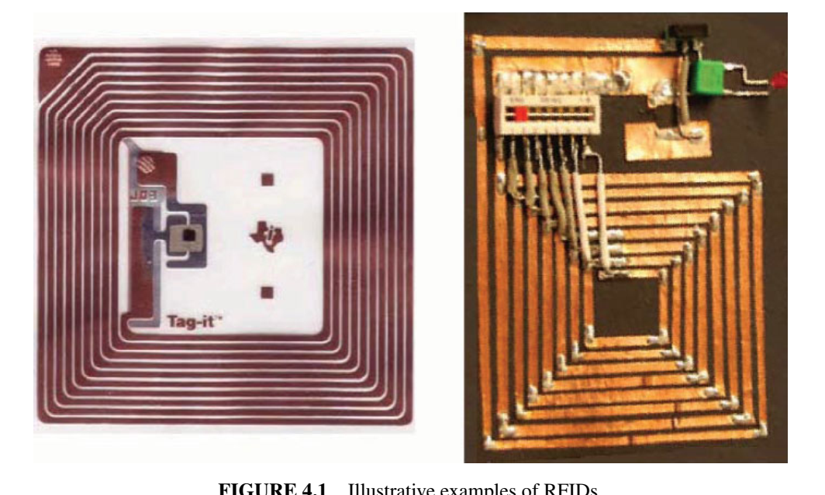
Introduction to RFID (Radio Frequency IDentification)
RFIDs are electronic devices associated with objects (“things”) that transmit their identity (usually a serial number) via radio links. The RFID space is large and well documented.
RFID tags are devices that typically have a read-only chip that stores a unique number but has no processing capability.
RFID tags have broad applications, including the rapid collection of data in commercial environments. For example, RFID and bar coding are nearly ubiquitous in the inventory process, providing both accuracy and speed of data collection.
These technologies facilitate the global supply chain and impact all subsystems within that overall process, including material requirement planning (MRP), just in time (JIT), electronic data interchange (EDI), and electronic commerce (EC).

Slide 6
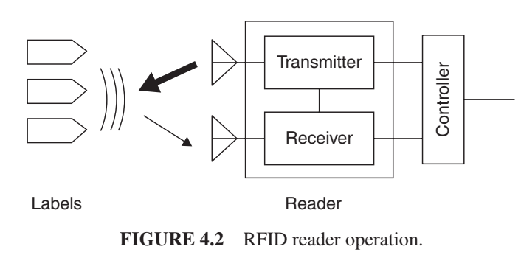
Introduction to RFID (Radio Frequency IDentification)
Contactless smart cards (SCs) are more sophisticated than RFID tags, being that they contain a microprocessor that enables (i) on-board computing, (ii) two-way communication including encryption, and (iii) storage of predefined and newly acquired information.

Slide 7
Introduction to RFID (Radio Frequency IDentification)
Because of their more restricted capabilities, RFID tags are typically less expensive than SCs.
When an RFID tag or contactless SC passes within a defined range, a reader generates electromagnetic waves;
the tag’s integrated antenna receives the signal and activates the chip in the tag/SC, and
a wireless communications channel is set up between the reader and the tag enabling the transfer of pertinent data
RFID examples applicable to IoT include but are not limited to the following:
Warehouse retailer automotive
Grocery chain transportation
Distribution center asset management
Manufacturing
Inventory management
Warehousing and distribution
Shop floor (production)
Document tracking and asset management
Industrial applications (e.g., time and attendance, shipping document tracking, receiving fixed assets)
Retail applications

Slide 8
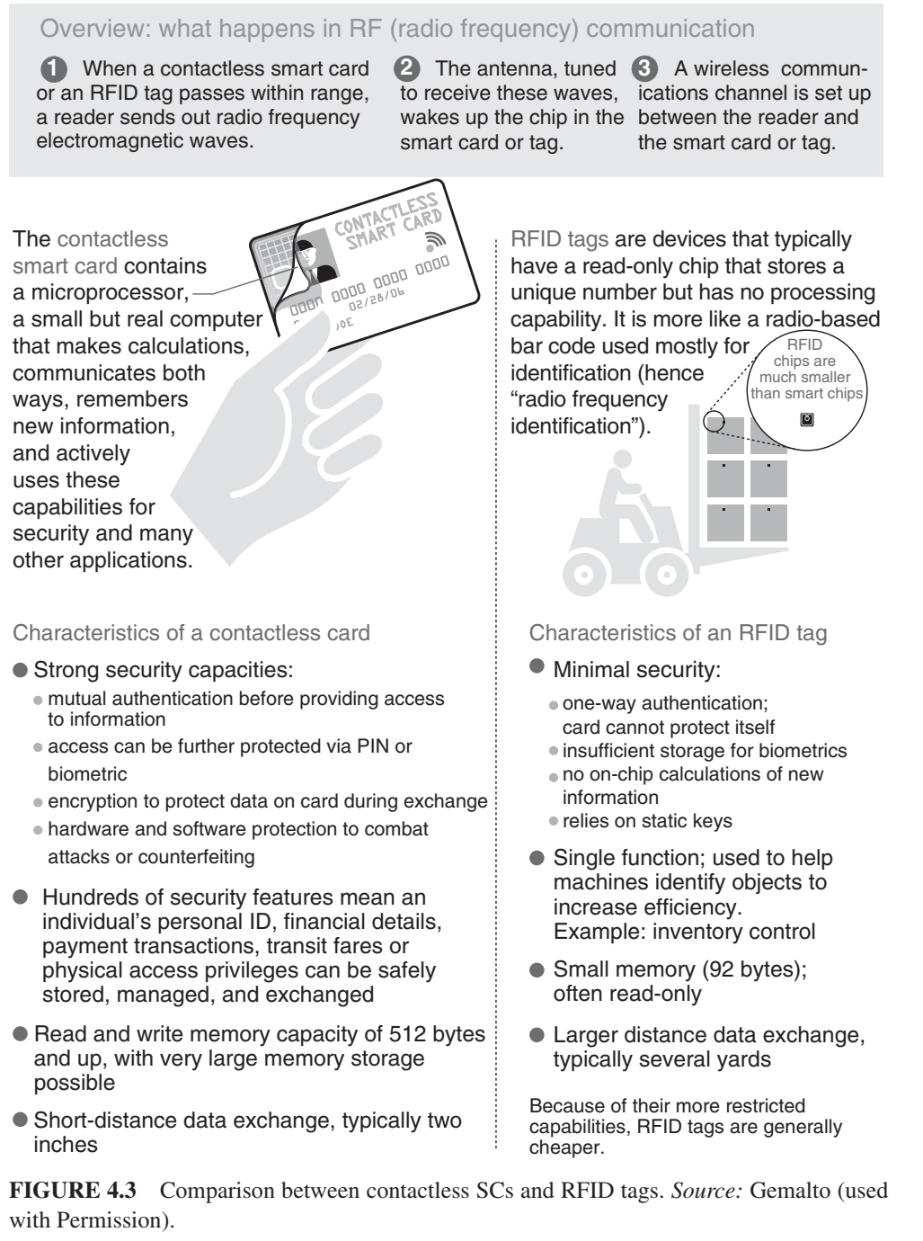

Slide 9
Introduction to RFID (Radio Frequency IDentification)
There are a number of standards for RFIDs. Some of the key ones include the following:
The ISO 14443 standard describes components operating at 13.56 MHz frequency that embed a CPU; power consumption is about 10mW; data throughput is about 100 Kbps and the maximum working distance (from the reader) is around 10 cm.
The ISO 15693 standard also describes components operating at 13.56 MHz frequency, but it enables working distances as high as 1 m, with a data throughput of a few Kbps.
The ISO 18000 standard defines parameters for air interface communications associated with frequency such as 135 KHz, 13.56 MHz, 2.45 GHz, 5.8 GHz, 860–960 MHz, and 433 MHz.
The ISO 18000–6 standard uses the 860–960 MHz range and is the basis for the Class-1 Generation-2 UHF RFID, introduced by the EPCglobal Consortium.
EPC- Electronic Product Code

Slide 10
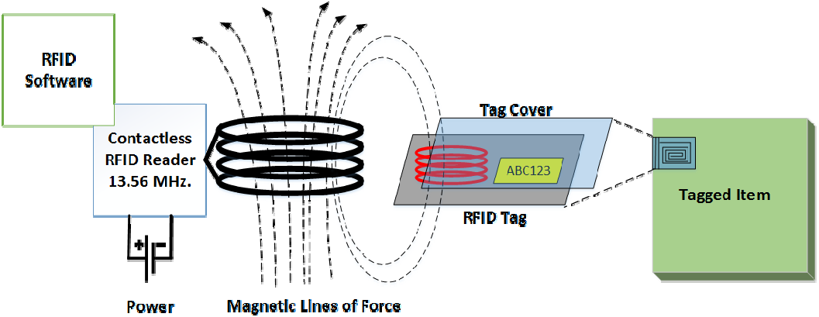
Introduction to RFID (Radio Frequency IDentification)
An RFID system is logically comprising several layers, as follows: the tag layer, the air interface (also called media interface) layer, and the reader layer; additionally there are network, middleware, and application aspects. Some of the key aspects of the basic layers are as follows:
Tag (device) layer: Architecture and EPCglobal Gen2 tag finite state machine
Media interface layer: Frequency bands, antennas, read range, modulation, encoding, data rates
Reader layer: Architecture, antenna configurations, Gen2 sessions, Gen2

Slide 11
Introduction to NFC( Near Field Communication)
A group of standards for devices such as PDAs, smartphones, and tablets that support the establishment of wireless communication when such devices are in immediate proximity of a few inches. These standards encompass communications protocols and data exchange formats; they are based on existing RFID standards
NFC can be used for IoT/M2M applications; it provides wireless connectivity, but it is not a WBAN technology.
NFC is a form of contactless communication between devices such as smartphones, tablets, and other devices.
Contactless communication allows a user to wave the smartphone over an NFC-compatible device to send
information without needing to touch the devices together or go through multiple steps setting up a connection.
NFC is an offshoot of radio frequency identification (RFID), with the exception that NFC is designed for use by devices within close proximity to each other.
NFC utilizes electromagnetic radio fields while technologies such as Bluetooth and Wi-Fi rely on radio transmissions.

Slide 12
Introduction to NFC
As noted elsewhere in this text, Google has launched Google Wallet that supports MasterCard PayPass; PayPal offers money transfers between smartphones; and other companies are expected to offer comparable services.
As the technology grows, more NFC-compatible smartphones will be available and more stores will offer NFC card readers for customer use.
The technology behind NFC allows a device, known as a reader, interrogator, or active device, to create an electromagnetic field that interacts with another NFC compatible device or a small NFC tag holding the information the reader requires.
Passive devices, such as the NFC tag in smart posters, store information, and communicate with the reader, but these devices do not actively read other devices.
Peer-to-peer communication through two active devices is also possible with NFC, allowing both devices to send and receive information.

Slide 13
Introduction to NFC
Three forms of NFC technology exist— Type A, Type B, and FeliCa; all three types are similar, but communicate in slightly different ways.
Compatibility is the key to the growth of NFC as a popular payment and data communication method; hence, NFC-based device must be able to communicate with other wireless technologies and be able to interact with different types of NFC transmissions.
NFC maintains interoperability between different wireless communication methods such as Bluetooth and other NFC standards (e.g., FeliCa, popular in Japan) through the NFC Forum. Founded in 2004 by Sony, Nokia, and Philips, the forum enforces standards that manufacturers must meet when designing NFC compatible devices; this ensures that NFC is secure and remains easy to use with different versions of the technology.

Slide 14
Introduction to NFC
Two major specifications exist for NFC technology: ISO/IEC 14443 and ISO/IEC 18000-3.
The first defines the ID cards used to store information, such as that found in NFC tags.
The latter specifies the RFID communication used by NFC devices. ISO/IEC 18000-3 is an international standard for all devices communicating wirelessly at the 13.56 MHz frequency using Type A or Type B cards, as is the case for NFC.
The devices must be within 4 cm of each other before they can transfer information. The standards define
how a device and the NFC tag it is reading should communicate with one another.
The device is known as the interrogating device while the NFC tag is simply referred to as the tag.
To operate, the interrogator sends out a signal to the tag. If the devices are close enough to each other, the tag becomes powered by the interrogator’s signal. Since the interrogator’s signal powers the tag, the tag can be small in size and can function without any battery or power source of its own.

Slide 15
Introduction to NFC
The two devices create a high frequency magnetic field between the loosely coupled coils in both the interrogating device and the NFC tag.
Once this field is established, a connection is formed and the information can be passed between the interrogator and the tag.
The interrogator sends the first message to the tag to find out what type of communication the tag uses, such as Type A or Type B. When the tag responds, the interrogator sends its first commands in the appropriate specification.
The tag receives the instruction and checks if it is valid. If not, nothing occurs. If it is a valid request, the tag then responds with the requested information. For sensitive transactions such as credit card payments, a secure communication channel is first established, and all information sent is encrypted.
NFC tags function at half duplex; the interrogator functions at full duplex. Half duplex refers to a device that can only send or receive, but not both at once; full duplex can do both simultaneously.

Slide 16
Introduction to NFC
Devices using NFC may be active or passive. A passive device, such as an NFC tag, contains information that other devices can read but does not read any information itself; an example could be a poster or a commercial sign on a wall where other devices can read the information, but the sign itself only transmits the stored information to authorized devices.
Active devices can read information and send it. An active NFC device, such as a smartphone, is not only able to collect information from NFC tags, but it is also able to exchange information with other compatible phones or devices and could even alter the information on the NFC tag if authorized to make such changes.
To ensure security, NFC often establishes a secure channel and uses encryption when sending sensitive information such as credit card numbers. Users can further protect their private data by keeping antivirus software on their smartphones and adding a password to the phone.

Slide 17
Introduction to NFC
Advantages:
NFC technology consumes little power when compared to standard Bluetooth technology
NFC technology comes in its ease of use.
Bluetooth requires users to manually set up connections between smartphones and takes several seconds. NFC connects automatically in a fraction of a second. Although the users must be close to one another to use NFC
technology, it is faster and easier to set up than a Bluetooth connection.

Slide 18
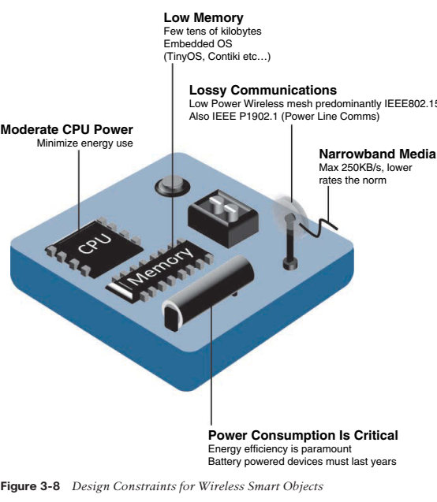
Wireless Sensor Networks (WSNs)
Wireless sensor networks are made up of wirelessly connected smart objects, which are sometimes referred to as motes. The fact that there is no infrastructure to consider with WSNs is surely a powerful advantage for flexible deployments, but there are a variety of design constraints to consider with these wirelessly connected smart objects. Figure illustrates some of these assumptions and constraints usually involved in WSNs.

Slide 19
Wireless Sensor Networks (WSNs)
The following are some of the most significant limitations of the smart objects in WSNs:
■ Limited processing power
■ Limited memory
■ Lossy communication
■ Limited transmission speeds
■ Limited power
These limitations greatly influence how WSNs are designed, deployed, and utilized. The fact that individual sensor nodes are typically so limited is a reason that they are often deployed in very large numbers. As the cost of sensor nodes continues to decline, the ability to deploy highly redundant sensors becomes increasingly feasible. Because many sensors are very inexpensive and correspondingly inaccurate, the ability to deploy smart objects redundantly allows for increased accuracy.
Smart objects with limited processing, memory, power, and so on are often referred to as constrained nodes.
Such large numbers of sensors permit the introduction of hierarchies of smart objects. Such a hierarchy provides, among other organizational advantages, the ability to aggregate similar sensor readings from sensor nodes that are in close proximity to each other.

Slide 20
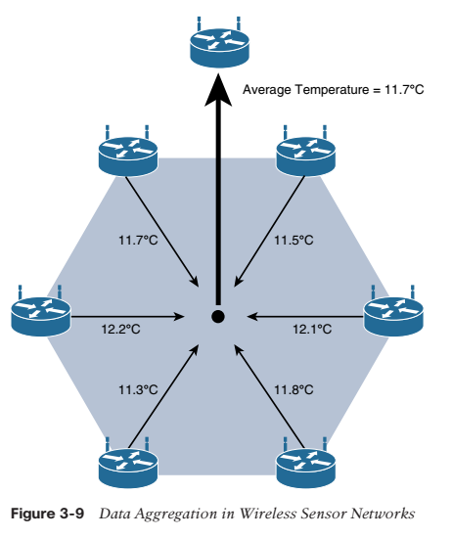
Wireless Sensor Networks (WSNs)
Data aggregation function in a WSN where temperature readings from a logical grouping of temperature sensors are aggregated as an average temperature reading.

Slide 21
Wireless Sensor Networks (WSNs)
These data aggregation techniques are helpful in reducing the amount of overall traffic (and energy) in WSNs with very large numbers of deployed smart objects.
This data aggregation at the network edges is where fog and mist computing.
Wirelessly connected smart objects generally have one of the following two communication patterns:
■ Event-driven: Transmission of sensory information is triggered only when a smart object detects a particular event or predetermined threshold.
■ Periodic: Transmission of sensory information occurs only at periodic intervals.
The decision of which of these communication schemes is used depends greatly on the specific application. For example, in some medical use cases, sensors periodically send postoperative vitals, such as temperature or blood pressure readings. In other medical use cases, the same blood pressure or temperature readings are triggered to be sent only when certain critically low or high readings are measured.
As WSNs grow to very large numbers of smart objects, there is a trend toward ever increasing levels of autonomy. For example, manual configuration of potentially thousands of smart objects is impractical and unwieldy, so smart objects in a WSN are typically self-configuring or automated by an IoT management platform in the background.

Slide 22
Wireless Sensor Networks (WSNs)
This technology has practically limitless capabilities, such as military (for example, detecting enemy troop movement), environmental (for example, detecting earthquakes or forest fires), and industrial (for example, detecting manufacturing anomalies, asset tracking).
Some level of self-organization is required for networking the scads of wireless smart objects such that these nodes autonomously come together to form a true network with a common purpose.
This capability to self-organize is able to adapt and evolve the logical topology of a WSN to optimize communication (among nodes as well as to centralized wireless controllers), simplify the introduction of
new smart objects, and improve reliability and access to services.
Additional advantages of being able to deploy large numbers of wireless low-cost smart objects are the inherent ability to provide fault tolerance, reliability, and the capability to extend the life of a WSN, especially in scenarios where the smart objects have limited battery life.
Autonomous techniques, such as self-healing, self-protection, and self-optimization, are often employed to perform these functions on behalf of an overall WSN system.
This is the basis of IoT, and it opens up a world of possibility, embedding sensors and/or actuators in everyday objects and networking them to enable sophisticated and well-coordinated automations that improves and simplifies our lives.

Slide 23
Narrow band IoT (NbIOT)
Recognizing that the definition of new LTE device categories was not sufficient to support LPWA IoT requirement, 3GPP specified Narrowband IoT (NB-IoT). The work on NB-IoT started with multiple proposals pushed by the involved vendors, including the following:
■ Extended Coverage GSM (EC-GSM), Ericsson proposal
■ Narrowband GSM (N-GSM), Nokia proposal
■ Narrowband M2M (NB-M2M), Huawei/Neul proposal
■ Narrowband OFDMA (orthogonal frequency-division multiple access), Qualcomm proposal
■ Narrowband Cellular IoT (NB-CIoT), combined proposal of NB-M2M and NB-OFDMA
■ Narrowband LTE (NB-LTE), Alcatel-Lucent, Ericsson, and Nokia proposal
■ Cooperative Ultra Narrowband (C-UNB), Sigfox proposal
Consolidation occurred with the agreement to specify a single NB-IoT version based on orthogonal frequency-division multiple access (OFDMA) in the downlink and a couple options for the uplink. OFDMA is a modulation scheme in which individual users are assigned subsets of subcarrier frequencies. This enables multiple users to transmit low speed data simultaneously.
Three modes of operation are applicable to NB-IoT:
■ Standalone: A GSM carrier is used as an NB-IoT carrier, enabling reuse of 900 MHz or 1800 MHz.

Slide 24
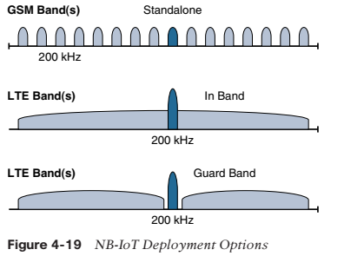
Narrow band IoT (NbIOT)
■ In-band: Part of an LTE carrier frequency band is allocated for use as an NB-IoT frequency. The service provider typically makes this allocation, and IoT devices are configured accordingly. You should be aware that if these devices must be deployed across different countries or regions using a different service provider, problems may occur unless there is some coordination between the service providers, and the NB-IoT frequency band allocations are the same.
■ Guard band: An NB-IoT carrier is between the LTE or WCDMA bands. This requires coexistence between LTE and NB-IoT bands.
NB-IoT is defined for a 200-kHz-wide channel in both uplink and downlink, allowing mobile service providers to optimize their spectrum, with a number of deployment options for GSM, WCDMA, and LTE spectrum

Slide 25
Narrow band IoT (NbIOT)
In an LTE network, resource blocks are defined with an effective bandwidth of 180 kHz, while on NB-IoT, tone or subcarriers replace the LTE resource blocks. The uplink channel can be 15 kHz or 3.75 kHz or multi-tone (n*15 kHz, n up to 12).
At Layer 1, the maximum transport block size (TBS) for downlink is 680 bits, while uplink is 1000 bits.
At Layer 2, the maximum Packet Data Convergence Protocol (PDCP) service data unit (SDU) size is 1600 bytes.
NB-IoT operates in half-duplex frequency-division duplexing (FDD) mode with a maximum data rate uplink of 60 kbps and downlink of 30 kbps.
Topology: NB-IoT is defined with a link budget of 164 dB; compare this with the GPRS link budget of 144 dB, used by many machine-to-machine services. The additional 20 dB link budget increase should guarantee better signal penetration in buildings and basements while achieving battery life requirements.

Slide 26
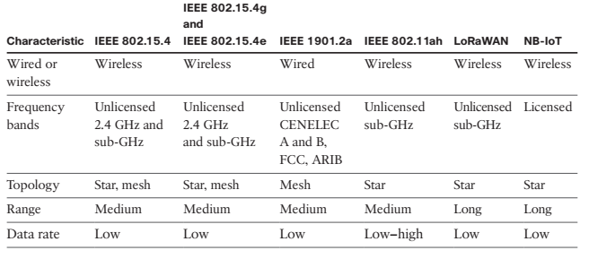
Narrow band IoT (NbIOT)
NB-IoT represents the future of LPWA technology for the mobile service providers who own licensed-band spectrum. IoT-related specifications must be completed and published by 3GPP to enable vendors, mobile service providers, and applications to successfully and widely endorse the technology.
Evolution to eSIMs, which are still not widely supported, should be tied to NB-IoT as managing millions of SIM cards may not be an acceptable path for the market.
An eSIM card is compliant across multiple operators and also reconfigurable. This means that it is a permanent part of the device and is easily rewritten if the device is switched to a different provider.

Slide 27
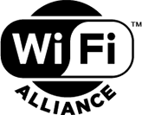
Wi-Fi
Wi-Fi is a family of wireless network protocols, based on the IEEE 802.11 family of standards, which are commonly used for local area networking of devices and Internet access. Wi‑Fi is a trademark of the non-profit Wi-Fi Alliance, which restricts the use of the term Wi-Fi Certified to products that successfully complete interoperability certification testing. As of 2010, the Wi-Fi Alliance consisted of more than 375 companies from around the world. As of 2009, Wi-Fi-integrated circuit chips shipped approximately 580 million units yearly. Devices that can use Wi-Fi technologies include desktops and laptops, smartphones and tablets, smart TVs, printers, digital audio players, digital cameras, cars, and drones.
Wi-Fi
Wi-Fi Alliance
Introduced | 21 September 1998; 21 years ago
Compatible hardware | Personal computers, gaming consoles, Smart Devices, televisions, printers, mobile phones

Slide 28
Wi-Fi
Wireless Technology is an alternative to Wired Technology which is commonly used for connecting devices in wireless mode.
Wi-Fi (Wireless Fidelity) is a generic term that refers to IEEE 802.11 standard for Wireless Local Area Networks (WLANs).
Wi-Fi Network connect computers to each other, to the internet and to the wired network.
Wi-Fi Networks use Radio Technologies to transmit and receive data at high speed:
❖ IEEE 802.11b
❖ IEEE 802.11a
❖ IEEE 802.11g
IEEE 802.11b
❖ Appear in late 1999
❖ Operates at 2.4GHz radio spectrum
❖ 11 Mbps (theoretical speed) - within 30 m Range
❖ 4-6 Mbps (actual speed)
❖ 100 -150 feet range
❖ Most popular, Least Expensive
❖ Interference from mobile phones and Bluetooth devices which can reduce the transmission speed.

Slide 29
Wi-Fi
IEEE 802.11a
❖ Introduced in 2001
❖ Operates at 5 GHz (less popular)
❖ 54 Mbps (theoretical speed)
❖ 15-20 Mbps (Actual speed)
❖ 50-75 feet range
❖ More expensive
❖ Not compatible with 802.11b
IEEE 802.11g
❖ Introduced in 2003
❖ Combine the feature of both standards (a, b)
❖ 100-150 feet range
❖ 54 Mbps Speed
❖ 2.4 GHz radio frequencies
❖ Compatible with „b‟

Slide 30
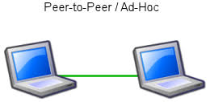
Wi-Fi
Elements of a WI-FI Network
Access Point (AP) - The AP is a wireless LAN transceiver or “base station” that can connect one or many wireless devices simultaneously to the Internet.
Wi-Fi cards - They accept the wireless signal and relay information. They can be internal and external. Safeguards - Firewalls and anti-virus software protect networks from uninvited users and keep information secure.
Wi-Fi Network Topologies
❖ Peer-to-peer topology (Ad-hoc Mode)
❖ AP-based topology (Infrastructure Mode)
Peer-to-peer topology
❖ AP is not required.
❖ Client devices within a cell can communicate with each other directly.
❖ It is useful for setting up a wireless network quickly and easily.

Slide 31
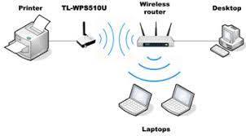
Wi-Fi
Infrastructure network
❖ The client communicate through Access Point.
❖ Any communication has to go through AP.
❖ If a Mobile Station (MS), like a computer, a PDA, or a phone, wants to communicate with another MS, it needs to send the information to AP first, then AP sends it to the destination MS.
How a Wi-Fi Network Works
❖ A Wi-Fi hotspot is created by installing an access point to an internet connection.
❖ An access point acts as a base station.
❖ When Wi-Fi enabled device encounters a hotspot the device can then connect to that network wirelessly.
❖ A single access point can support up to 30 users and can function within a range of 100 – 150 feet indoors and up to 300 feet outdoors.
❖ Many access points can be connected to each other via Ethernet cables to create a single large network.

Slide 32
Wi-Fi
Advantages
❖ Mobility
❖ Ease of Installation
❖ Flexibility
❖ Cost
❖ Reliability
❖ Security
❖ Use unlicensed part of the radio spectrum
❖ Roaming
❖ Speed
Limitations
❖ Interference
❖ Degradation in performance
❖ High power consumption
❖ Limited range

Slide 33
PLC Communication Protocol : A comparison
IEEE 1901.2a
While most of the constrained network technologies relate to wireless, IEEE 1901.2a-2013 is a wired technology that is an update to the original IEEE 1901.2 specification. This is a standard for Narrowband Power Line Communication (NB-PLC). NB-PLC leverages a narrowband spectrum for low power, long range, and resistance to interference over the same wires that carry electric power.
NB-PLC is often found in use cases such as the following:
■ Smart metering: NB-PLC can be used to automate the reading of utility meters, such as electric, gas, and water meters. This is true particularly in Europe, where PLC is the preferred technology for utilities deploying smart meter solutions.
■ Distribution automation: NB-PLC can be used for distribution automation, which involves monitoring and controlling all the devices in the power grid.
■ Public lighting: A common use for NB-PLC is with public lighting—the lights found in cities and
along streets, highways, and public areas such as parks.
■ Electric vehicle charging stations: NB-PLC can be used for electric vehicle charging stations, where the batteries of electric vehicles can be recharged.

Slide 34
■ Microgrids: NB-PLC can be used for microgrids, local energy grids that can disconnect from the traditional grid and operate independently.
■ Renewable energy: NB-PLC can be used in renewable energy applications, such as solar, wind power, hydroelectric, and geothermal heat.
Multiple PLC standards exist, but the formation of IEEE 1901.2a was driven by the absence of a low-frequency PLC solution below 500 kHz. IEEE 1901.2a specifies the use of both alternating and direct current electric power lines.
Low- and medium-voltage lines in both indoor and outdoor environments are supported, along with multiple-mile distances. Data rates can scale up to 500 kbps. The IEEE 1901.2a PHY and MAC layers can be mixed with IEEE 802.15.4g/e on endpoints, offering a dual-PHY solution for some use cases.
Standardization and Alliances
The first generations of NB-PLC implementations have generated a lot of interest from utilities in Europe but have often suffered from poor reliability, low throughput (in the range of a few hundred bits per second to a maximum of 2 kbps), lack of manageability, and poor interoperability.
Most recent NB-PLC standards are based on orthogonal frequency-division multiplexing (OFDM). However, different standards from various vendors competing with one another have created a fragmented market.
OFDM encodes digital data on multiple carrier frequencies. This provides several parallel streams that suffer less from high frequency attenuation in copper wire and narrowband interference.

Slide 35
PLC (also called powerline communication as a singular term; also called powerline telecommunications [or PLT]) refers to any technology that enables data transfer through powerlines.
Data communication can take place at NB or broadband speeds. The technology has been around since the 1950s, but initially only supported NB applications for relay management, for example for public lighting.
Broadband over PLC only began at the end of the 1990s. PLC is thus a term used to identify technologies, equipment's, applications, and services aiming at providing users with communication means over existing
“powerlines” (cables transmitting electricity).
As for the term access PLC, it is used to identify those PLC solutions aiming at providing consumers with broadband services through the external electricity grid, while in-home PLC is used to identify PLC solutions aiming at applications within the home.
PLC transmission works by superimposing a high-frequency signal at low-energy levels over the 50 Hz electrical signal. The powerline is transformed into a communication network through the superposition of a low-energy information signal to the power wave.
In order to ensure a suited coexistence and separation between the two systems, the frequency range used for communication is very far from the one used for the power wave (50 Hz in Europe): 3–148.5 kHz for PLC NB applications and from 1–30 MHz for PLC broadband applications.

Slide 36
The modulated signal is transmitted via the power infrastructure and can be received and decoded remotely. Thus, the PLC signal is received by any PLC receiver located on the same electrical network.
An integrated coupler at the PLC receiver entry points eliminates low frequency components before the signal is treated.
There now is standardization work underway in the PLC Forum and in ETSI. CENELEC has issued regulations for transmission in defined bands. The CENELEC A-band is reserved by law in CENELEC regulated countries for the exclusive use of utilities and their licensees.
The CENELEC C-band is available for consumer and commercial use without restriction, but a common access protocol and coexistence protocol is mandated.
NB applications include home control, home automation, automatic meter reading, remote surveillance, and control of home appliances. Broadband applications include (for access PLC) Internet access, telephony, TV and (for in-home PLC) Internet access sharing, computer resource sharing, and AV whole-house distribution.
PLC can be used in places where radio frequency (RF) cannot be used or is unreliable; for example, smart meters in the basement of a building are unlikely to be able to use RF to communicate with the neighborhood data concentrator
PLC communication can utilize the power wires to reach the data concentrator. It is estimated today that more than 80 PLC initiatives in more than 40 countries have been launched, worldwide, by electric utilities.

Slide 37
IEEE 1901 is a group of PLC standards that enables transmission of data over AC electrical powerlines. Its goal was to replace a set of different powerline specs now in existence but maintaining a mandatory coexistence with legacy PLC approaches.
There are two basic standards: (i) a BPL standard and (ii) a low-frequency narrowband (LF NB) standard.
The term broadband over powerline (BPL) is used to underline the technology capability to address broadband services. As for the term Access PLC, it is used to identify those PLC solutions aiming at providing
consumers with broadband services through the external electricity grid, while in-home PLC is used to identify PLC solutions aiming at applications within the home
Basic applications include the use of in-home wires to distribute signals to support Smart Grid & Smart Energy, HDTV Networking, Whole Home Audio, and Gaming. Technology standards defined by the Alliance include the following:
HomePlug Green PHYTM (“GP”)
IEEE 1901 Powerline Networking Standard
HomePlug Broadband-Speed Technologies
SE Profile 2

Slide 38
Physical Layer: NB-PLC is defined for frequency bands from 3 to 500 kHz. Much as with wireless subGHz frequency bands, regional regulations and definitions apply to NB-PLC. The IEEE 1901.2 working group has integrated support for all world regions in order to develop a worldwide standard.
One major difference between IEEE 802.15.4g/e and IEEE 1901.2a is the full integration of different types of modulation and tone maps by a single PHY layer in the IEEE 1901.2a specification. IEEE 802.15.4g/e doesn’t really define a multi-PHY management algorithm.
The PHY payload size can change dynamically, based on channel conditions in IEEE 1901.2a. Therefore, MAC sublayer segmentation is implemented. If the size of the MAC payload is too large to fit within one PHY service data unit (PSDU), the MAC payload is partitioned into smaller segments.
MAC payload segmentation is done by dividing the MAC payload into multiple smaller amounts of data (segments), based on PSDU size.
The segmentation may require the addition of padding bytes to the last payload segment so that the final MPDU fills the PSDU. All forms of addressing (unicast and broadcast) are subject to segmentation.
MAC Layer: The MAC frame format of IEEE 1901.2a is based on the IEEE 802.15.4 MAC frame but integrates the latest IEEE 802.15.4e-2012 amendment, which enables key features to be supported. One of the key components brought from 802.15.4e to IEEE 1901.2a is information elements.

Slide 39
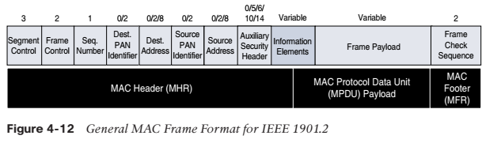
Topology:
Use cases and deployment topologies for IEEE 1901.2a are tied to the physical power lines. As with wireless technologies, signal propagation is limited by factors such as noise, interference, distortion, and attenuation.
These factors become more prevalent with distance, so most NB-PLC deployments use some sort of mesh topology.
Mesh networks offer the advantage of devices relaying the traffic of other devices so longer distances can
be segmented. Figure 4-13 highlights a network scenario in which a PLC mesh network is applied to a neighbourhood.
The IEEE 1901.2a standard offers the flexibility to run any upper-layer protocol. So, implementations of IPv6 6LoWPAN and RPL IPv6 protocols are supported. These protocols enable the use of network layer routing to create mesh networks over PLC.

Slide 40
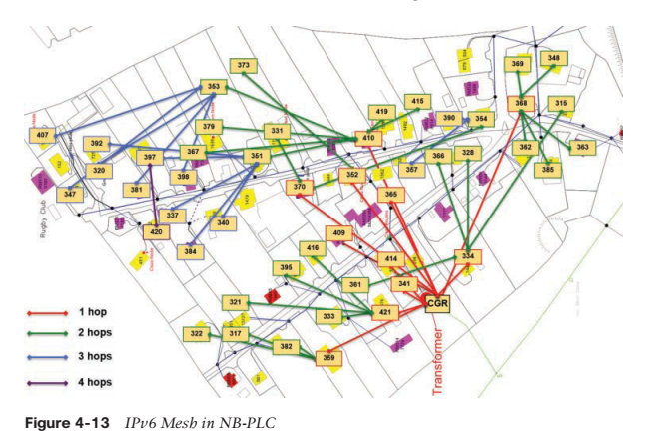

Slide 41
Security: IEEE 1901.2a security offers similar features to IEEE 802.15.4g. Encryption and authentication are performed using AES. In addition, IEEE 1901.2a aligns with 802.15.4g in its ability to support the IEEE 802.15.9 Key Management Protocol. However, some differences exist. These differences are mostly tied to the PHY layer fragmentation capabilities of IEEE 1901.2a and include the following:
■ The Security Enabled bit in the Frame Control field should be set in all MAC frames carrying segments of an encrypted frame.
■ If data encryption is required, it should be done before packet segmentation. During packet encryption, the
Segment Control field should not be included in the input to the encryption algorithm.
■ On the receiver side, the data decryption is done after packet reassembly.
■ When security is enabled, the MAC payload is composed of the ciphered payload and the message integrity code (MIC) authentication tag for non-segmented payloads. If the payload is segmented, the MIC is part of the last packet (segment) only. The MIC authentication is computed using only information from the MHR of the
frame carrying the first segment.

Slide 42
Popular radio protocols and its security drawbacks
IEEE 802.15.4
ZigBee
ZigBee Smart Energy
DigiMesh (Digi proprietary)
ZWAVE
IEEE 802.11 (Wi-Fi)
Bluetooth
BLE

Slide 43
802.15.4 in depth
IEEE 802.15.4 is a wireless access technology for low-cost and low-data-rate devices that are powered or run on batteries. In addition to being low cost and offering a reasonable battery life, this access technology enables easy installation using a compact protocol stack while remaining both simple and flexible.
Several network communication stacks, including deterministic ones, and profiles leverage this technology to address a wide range of IoT use cases in both the consumer and business markets.
IEEE 802.15.4 is commonly found in the following types of deployments:
■ Home and building automation
■ Automotive networks
■ Industrial wireless sensor networks
■ Interactive toys and remote controls
Criticisms of IEEE 802.15.4 often focus on its MAC reliability, unbounded latency, and susceptibility to interference and multipath fading. The negatives around reliability and latency often have to do with the Collision Sense Multiple Access/Collision Avoidance (CSMA/CA) algorithm.
CSMA/CA is an access method in which a device “listens” to make sure no other devices are transmitting before starting its own transmission. If another device is transmitting, a wait time (which is usually random) occurs before “listening” occurs again. Interference and multipath fading occur with IEEE 802.15.4 because it lacks a frequency-hopping technique.

Slide 44
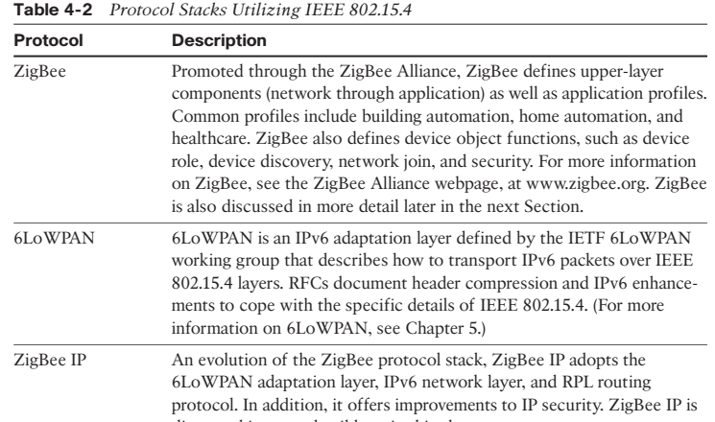
802.15.4 in depth

Slide 45
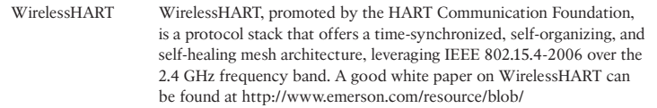
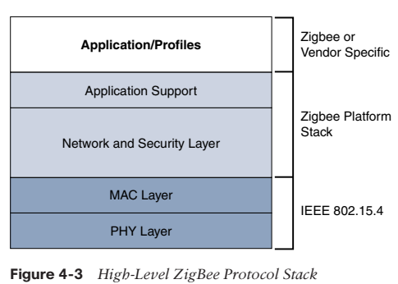
802.15.4 in depth
The traditional ZigBee stack is illustrated in Figure 4-3. As mentioned previously, ZigBee utilizes the IEEE 802.15.4 standard at the lower PHY and MAC layers. ZigBee specifies the network and security layer and application support layer that sit on top of the lower layers

Slide 46
802.15.4 in depth
The ZigBee network and security layer provides mechanisms for network startup, configuration, routing, and securing communications. This includes calculating routing paths in what is often a changing topology, discovering neighbors, and managing the routing tables as devices join for the first time.
The network layer is also responsible for forming the appropriate topology, which is often a mesh but could be a star or tree as well. From a security perspective, ZigBee utilizes 802.15.4 for security at the MAC layer, using the Advanced Encryption Standard (AES) with a 128-bit key and also provides security at the network and application layers.
ZigBee IP: With the introduction of ZigBee IP, the support of IEEE 802.15.4 continues, but the IP and TCP/UDP protocols and various other open standards are now supported at the network and transport layers. The ZigBee-specific layers are now found only at the top of the protocol stack for the applications. ZigBee IP was created to embrace the open standards coming from the IETF’s work on LLNs, such as IPv6, 6LoWPAN, and RPL. They provide for low-bandwidth, low-power, and cost-effective communications when connecting smart objects.

Slide 47
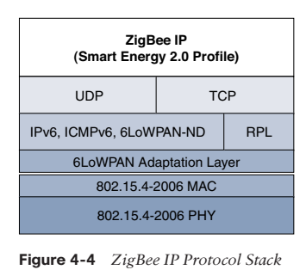
802.15.4 in depth

Slide 48
802.15.4 in depth
Physical Layer: The 802.15.4 standard supports an extensive number of PHY options that range from 2.4 GHz to sub-GHz frequencies in ISM bands. The original IEEE 802.15.4-2003 standard specified only three PHY options based on direct sequence spread spectrum (DSSS) modulation. DSSS is a modulation technique in which a signal is intentionally spread in the frequency domain, resulting in greater bandwidth. The original physical layer transmission options were as follows:
■ 2.4 GHz, 16 channels, with a data rate of 250 kbps
■ 915 MHz, 10 channels, with a data rate of 40 kbps
■ 868 MHz, 1 channel, with a data rate of 20 kbps
You should note that only the 2.4 GHz band operates worldwide. The 915 MHz band operates mainly in North and South America, and the 868 MHz frequencies are used in Europe, the Middle East, and Africa.
IEEE 802.15.4-2006, 802.15.4-2011, and IEEE 802.15.4-2015 introduced additional PHY communication options, including the following:
■ OQPSK PHY: This is DSSS PHY, employing offset quadrature phase-shift keying (OQPSK) modulation. OQPSK is a modulation technique that uses four unique bit values that are signaled by phase changes. An offset function that is present during phase shifts allows data to be transmitted more reliably.
■ BPSK PHY: This is DSSS PHY, employing binary phase-shift keying (BPSK) modulation. BPSK specifies two unique phase shifts as its data encoding scheme.
compared to DSSS. ASK uses amplitude shifts instead of phase shifts to signal
different bit values.

Slide 49
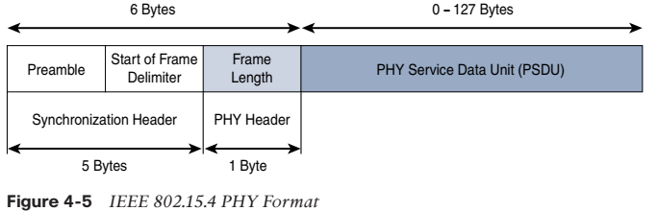
802.15.4 in depth
■ ASK PHY: This is parallel sequence spread spectrum (PSSS) PHY, employing amplitude shift keying (ASK) and BPSK modulation. PSSS is an advanced encoding scheme that offers increased range, throughput, data rates, and signal integrity compared to DSSS. ASK uses amplitude shifts instead of phase shifts to signal
different bit values.
These improvements increase the maximum data rate for both 868 MHz and 915 MHz to 100 kbps and 250 kbps, respectively. The 868 MHz support was enhanced to 3 channels, while other IEEE 802.15.4 study groups produced addendums for new frequency bands.
Figure 4-5 shows the frame for the 802.15.4 physical layer. The synchronization header for this frame is composed of the Preamble and the Start of Frame Delimiter fields. The Preamble field is a 32-bit 4-byte (for parallel construction) pattern that identifies the start of the frame and is used to synchronize the data transmission. The Start of Frame Delimiter field informs the receiver that frame contents start immediately after this byte.

Slide 50
802.15.4 in depth
The PHY Header portion of the PHY frame shown in Figure 4-5 is simply a frame length value. It lets the receiver know how much total data to expect in the PHY service data unit (PSDU) portion of the 802.4.15 PHY. The PSDU is the data field or payload.
MAC Layer:
The IEEE 802.15.4 MAC layer manages access to the PHY channel by defining how devices in the same area will share the frequencies allocated. At this layer, the scheduling and routing of data frames are also coordinated. The 802.15.4 MAC layer performs the following tasks:
■ Network beaconing for devices acting as coordinators (New devices use beacons to join an 802.15.4 network)
■ PAN association and disassociation by a device
■ Device security
■ Reliable link communications between two peer MAC entities
The MAC layer achieves these tasks by using various predefined frame types. In fact, four types of MAC frames are specified in 802.15.4:
■ Data frame: Handles all transfers of data
■ Beacon frame: Used in the transmission of beacons from a PAN coordinator

Slide 51
802.15.4 in depth
■ Acknowledgement frame: Confirms the successful reception of a frame
■ MAC command frame: Responsible for control communication between devices
Each of these four 802.15.4 MAC frame types follows the frame format shown in Figure 4-6. In Figure 4-6, notice that the MAC frame is carried as the PHY payload. The 802.15.4 MAC frame can be broken down into the MAC Header, MAC Payload, and MAC Footer fields.
The MAC Header field is composed of the Frame Control, Sequence Number and the Addressing fields. The Frame Control field defines attributes such as frame type, addressing modes, and other control flags.
The Sequence Number field indicates the sequence identifier for the frame. The Addressing field specifies the Source and Destination PAN Identifier fields as well as the Source and Destination Address fields.
The MAC Payload field varies by individual frame type. For example, beacon frames have specific fields and payloads related to beacons, while MAC command frames have different fields present. The MAC Footer field is nothing more than a frame check sequence (FCS). An FCS is a calculation based on the data in the frame that is used by the receiving side to confirm the integrity of the data in the frame.

Slide 52
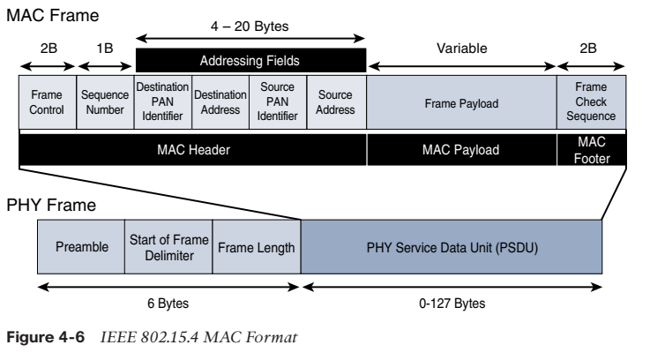
802.15.4 in depth

Slide 53
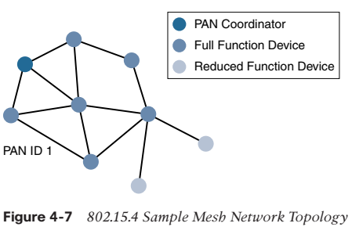
802.15.4 in depth
Topology: IEEE 802.15.4–based networks can be built as star, peer-to-peer, or mesh topologies. Mesh networks tie together many nodes. This allows nodes that would be out of range if trying to communicate directly to leverage intermediary nodes to transfer communications.
Please note that every 802.15.4 PAN should be set up with a unique ID. All the nodes in the same 802.15.4 network should use the same PAN ID. Figure 4-7 shows an example of an 802.15.4 mesh network with a PAN ID of 1.

Slide 54
802.15.4 in depth
Security:
The IEEE 802.15.4 specification uses Advanced Encryption Standard (AES) with a 128-bit key length as the base encryption algorithm for securing its data. AES is a block cipher, which means it operates on fixed-size blocks of data.
In addition to encrypting the data, AES in 802.15.4 also validates the data that is sent. This is accomplished by a message integrity code (MIC), which is calculated for the entire frame using the same AES key that is used for encryption.
Enabling these security features for 802.15.4 changes the frame format slightly and consumes some of the payload. Using the Security Enabled field in the Frame Control portion of the 802.15.4 header is the first step to enabling AES encryption. This field is a single bit that is set to 1 for security. Once this bit is set, a field called the Auxiliary Security Header is created after the Source Address field, by stealing some bytes from
the Payload field. Figure 4-8 shows the IEEE 802.15.4 frame format at a high level, with the Security Enabled bit set and the Auxiliary Security Header field present.

Slide 55
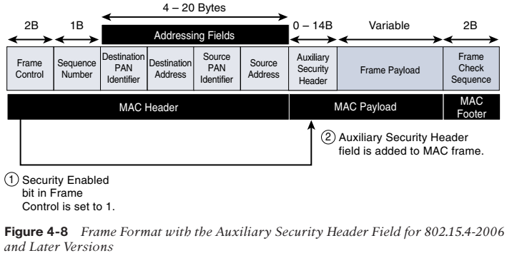
802.15.4 in depth

Slide 56
802.15.4 in depth
IEEE 802.15.4 Conclusions:
The IEEE 802.15.4 wireless PHY and MAC layers are mature specifications that are the foundation for various industry standards and products. The PHY layer offers a maximum speed of up to 250 kbps, but this varies based on modulation and frequency.
The MAC layer for 802.15.4 is robust and handles how data is transmitted and received over the PHY layer. Specifically, the MAC layer handles the association and disassociation of devices to/from a PAN, reliable communications between devices, security, and the formation of various topologies.
The topologies used in 802.15.4 include star, peer-to-peer, and cluster trees that allow for the formation of mesh networks. From a security perspective, 802.15.4 utilizes AES encryption to allow secure communications and also provide data integrity.

Slide 57
Network Layer Protocols- Introduction
IPv4
IPv6
6LoWPAN in depth
6TiSCH
ND
DHCP
ICMP
RPL
CORPL
CARP

Slide 58
IPv4
The IP address is an identifier that is applied to each device connected to an IP network. In this setup, different entities taking part in the network (servers, routers, user computers, and so on) communicate among each other using their IP address, as an entity identifier.
The current IPv4 naming scheme was developed in the 1970s and had capacity for about 4.3 billion addresses, which were grouped into 255 blocks of 16 million addresses each.
In IPv4, addresses consist of four octets. With IPv4, the 32-bit address can be represented as AdrClass|netID|hostID. The network portion can contain either a network ID or a network ID and a subnet. Every network and every host or device has a unique address, by definition.
For ease of human conversation, IP addresses are represented as separated by periods, for example: 166.74.110.83, where the decimal numbers are a shorthand and corresponds to the binary code described by the byte in question (an 8-bit number takes a value in the 0–255 range). Since the IPv4 address has 32 bits, there are nominally 232 different IP addresses (as noted, approximately 4.3 billion nodes, if all combinations are used).

Slide 59
IPv4
For 20+ years, the IETF has been working on transitioning the Internet from IP version 4 to IP version 6. The main driving force has been the lack of address space in IPv4 as the Internet has grown. IPv6 has a much larger range of addresses that should not be exhausted for the foreseeable future. Today, both versions of IP run over the Internet, but most traffic is still IPv4 based.
The Internet Protocol (IP) is a network-layer (Layer 3 in the OSI model) protocol that contains addressing information and some control information to enable packets to be routed in a network. IP is the primary network-layer protocol in the TCP/IP protocol suite.
Along with the Transmission Control Protocol (TCP), IP represents the heart of the Internet protocols. IP is equally well suited for both LAN and WAN communications.
IP has two primary responsibilities: providing connectionless, best-effort delivery of datagrams through a network; and providing fragmentation and reassembly of datagrams to support data links with different maximum-transmission unit (MTU) sizes.

Slide 60
IPv4
The IP addressing scheme is integral to the process of routing IP datagrams through an internetwork. Each IP address has specific components and follows a basic format. These IP addresses can be subdivided and used to create addresses for subnet-works.
Each computer (known as a host) on a TCP/IP network is assigned a unique 32-bit logical address that is divided into two main parts: the network number and the host number.
The network number identifies a network and must be assigned by the Internet Network Information Center (InterNIC) if the network is to be part of the Internet. An Internet Service Provider (ISP) can obtain blocks of network addresses from the InterNIC and can itself assign address space as necessary.
The host number identifies a host on a network and is assigned by the local network administrator.

Slide 61
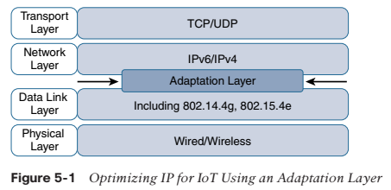
IPv4
The following are some of the main factors applicable to IPv4 and IPv6 support in an IoT solution:
Application Protocol
Cellular Provider and Technology
Serial Communications
IPv6 Adaptation Layer
Optimizing IP for IoT: While the Internet Protocol is key for a successful Internet of Things, constrained
nodes and constrained networks mandate optimization at various layers and on multiple
protocols of the IP architecture.

Slide 62
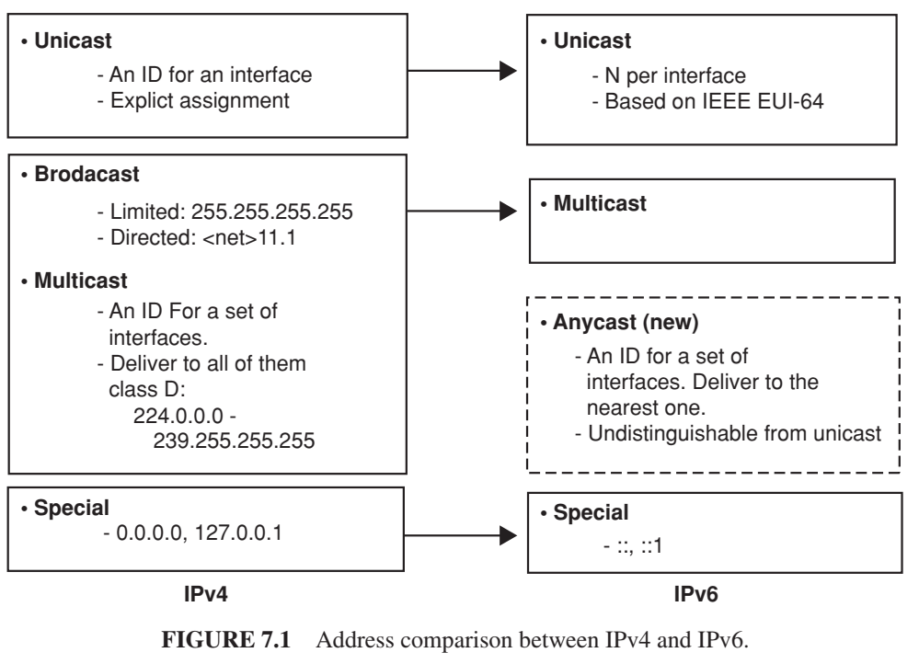

Slide 63
IPv6
IPv6 is the new version of Internet Protocol (IP) based on IPv4, a network-layer (Layer 3) protocol that contains addressing information and some control information enabling packets to be routed in the network.
There are two basic IP versions: IPv4 and IPv6. IPv6 is also called next generation IP or IPng. IPv4 and IPv6 are de-multiplexed at the media layer. For example, IPv6 packets are carried over Ethernet with the content type 86DD (hexadecimal) instead of IPv4’s 0800. This document describes the IPv6 details. The IPv4 is described in a separate document.
IPv6 increases the IP address size from 32 bits to 128 bits, to support more levels of addressing hierarchy, a much greater number of addressable nodes and simpler auto-configuration of addresses. IPv6 addresses are expressed in hexadecimal format (base 16) which allows not only numerals (0-9) but a few characters as well (a-f).
A sample ipv6 address looks like: 3ffe:ffff:100:f101:210:a4ff:fee3:9566. Scalability of multicast addresses is introduced. A new type of address called an anycast address is also defined, to send a packet to any one of a group of nodes. Two major improvements in IPv6 vs. v4:

Slide 64
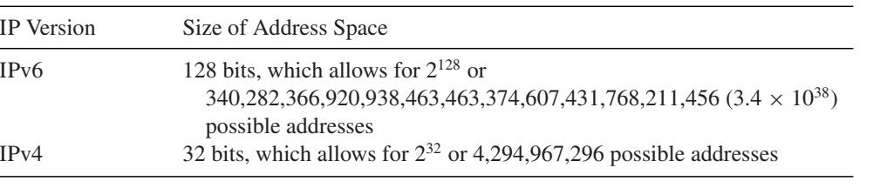
IPv6
Improved support for extensions and options - IPv6 options are placed in separate headers that are located between the IPv6 header and the transport layer header. Changes in the way IP header options are encoded allow more efficient forwarding, less stringent limits on the length of options, and greater flexibility for introducing new options in the futurHop-by-Hop Option, Routing (Type 0), Fragment, Destination Option, Authentication, and Encapsulation Payload.e. The extension headers are:
Flow labeling capability - A new capability has been added to enable the labeling of packets belonging to particular traffic flows for which the sender requests special handling, such as non-default Quality of Service or real-time service.

Slide 65
IPv6
The IPv6 address is represented as eight groups of 16 bits each, separated by the “:” character. Each 16-bit group is represented by 4 hexadecimal digits, that is, each digit has a value between 0 and f (0,1, 2, . . . a, b, c, d, e, f with a = 10, b = 11, and so on, to f = 15).
What follows is an IPv6 address example
3223:0ba0:01e0:d001:0000:0000:d0f0:0010
An abbreviated format exists to designate IPv6 addresses when all endings are 0. For example
3223:0ba0:: is the abbreviated form of the following address:
3223:0ba0:0000:0000:0000:0000:0000:0000
Similarly, only one 0 is written, removing 0’s in the left side, and four 0’s in the middle of the address. For example the address
3223:ba0:0:0:0:0::1234 is the abbreviated form of the following address
3223:0ba0:0000:0000:0000:0000:0000:1234
Auto-return or loopback virtual address. This address is specified in IPv4 as the 127.0.0.1 address. In IPv6, this address is represented as ::1.
Not specified address (::). This address is not allocated to any node since it is used to indicate absence of address.

Slide 66
6LoWPAN in depth
IPv6 over Low power Wireless Personal Area Network (6LoWPAN) is the first and most commonly used standard in this category. It efficiently encapsulates IPv6 long headers in IEEE802.15.4 small packets, which cannot exceed 128 bytes.
The specification supports different length addresses, low bandwidth, different topologies including star or mesh, power consumption, low cost, scalable networks, mobility, unreliability and long sleep time.
The standard provides header compression to reduce transmission overhead, fragmentation to meet the 128-byte maximum frame length in IEEE802.15.4, and support of multi-hop delivery.
Frames in 6LoWPAN use four types of headers: No 6loWPAN header (00), Dispatch header (01), Mesh header (10) and Fragmentation header (11).
In No 6loWPAN header case, any frame that does not follow 6loWPAN specifications is discarded. Dispatch header is used for multicasting and IPv6 header compressions. Mesh headers are used for broadcasting; while Fragmentation headers are used to break long IPv6 header to fit into fragments of maximum 128-byte length.

Slide 67
6LoWPAN in depth
The requirement for IPv6 connectivity in a LoWPAN is driven by the following (1):
1. The many devices in a LoWPAN make network autoconfiguration and statelessness highly desirable;
2. The large number of devices poses the need for a large address space, well met by IPv6;
3. Given the limited packet size of LoWPANs, the IPv6 address format allows subsuming of IEEE 802.15.4 addresses, if so desired;
4. Given the limited packet size, headers for IPv6 and layers above must be compressed whenever possible; and
5. Simple interconnectivity of the LoWPANs to other IP networks including the Internet.
Recent additional work items include the following (2):
1. Produce “6LoWPAN Bootstrapping and 6LoWPAN IPv6 ND Optimizations” to define limited extensions to IPv6 neighbor discovery for use specifically in low-power networks.
2. Produce “6LoWPAN Improved Header Compression” to describe mechanisms to allow enhancements to the 6LoWPAN headers.
3. Produce “6LoWPAN Architecture” to describe the design and implementation of 6LoWPAN networks.

Slide 68
6LoWPAN in depth
6LoWPANS GOALS
LoWPANs in general and IEEE 802.15.4-2003-based systems in particular have design constraints that need to be taken into consideration when developing a protocol stack. These constraints fall into two categories:
Communication constraints defined by the underlying personal area network (PAN):
◦ Small packet size. Given that the maximum physical layer packet is 127 bytes, the resulting maximum frame size at the media access control layer is 102 octets. Link-layer security imposes further overhead, leaving 81 octets for data packets. Adding all layers for IP connectivity should still allow transmission in one frame, without incurring excessive fragmentation and reassembly. Furthermore “control/protocol packets” fit within a single 802.15.4 frame;
◦ Support for both 16-bit short or IEEE 64-bit extended media access control addresses;
◦ Low bandwidth. Data rates of 250 Kbps, 40 Kbps, and 20 Kbps for each of the currently defined physical layers (2.4 GHz, 915 MHz, and 868 MHz, respectively);
◦ Topologies include star and mesh operation;
◦ Other issues to address include limited configuration and management capabilities, need for service discovery, and need for security (confidentiality and integrity protection).

Slide 69
6LoWPAN in depth
System constraints driven by the intended application parameters:
◦ Characteristic examples include low/battery power, low cost, low processing capabilities, small memory size, large population of devices, ad-hoc locations/logical topology, mobility, and unreliable nodal behaviors (e.g., due to uncertain radio connectivity, interference, sleep state, battery drain, device, etc.)
The requirements on the routing protocol are:
1. Given the minimal packet size of LoWPANs, the routing protocol must impose low (or no) overhead on data packets.
2. The routing protocols should have low routing overhead (low chattiness) balanced with topology changes and power conservation.
3. The computation and memory requirements in the routing protocol should be minimal to satisfy the low-cost and low-power objectives. Thus, storage and maintenance of large routing tables is detrimental.
4. Support for network topologies in which either FFDs or RFDs may be battery or mains powered. This implies the appropriate considerations for routing in the presence of sleeping nodes.

Slide 70
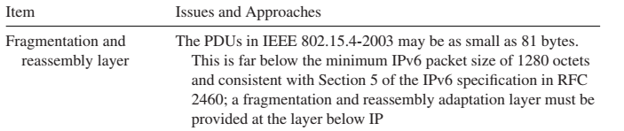
6LoWPAN in depth
All LoWPAN-encapsulated datagrams transported over IEEE 802.15.4 are prefixed by an encapsulation header stack. Each header in the header stack contains a header type followed by zero or more header fields. While in an IPv6 header, the stack would contain, in the following order, addressing, hop-by-hop options, routing,
fragmentation, destination options, and finally payload; in a LoWPAN header, the analogous header sequence is mesh (layer 2) addressing, hop-by-hop options (including layer 2 broadcast/multicast), fragmentation, and finally payload.
When more than one LoWPAN header is used in the same packet, they must appear in the following order:
1. Mesh addressing header
2. Broadcast header
3. Fragmentation header

Slide 71
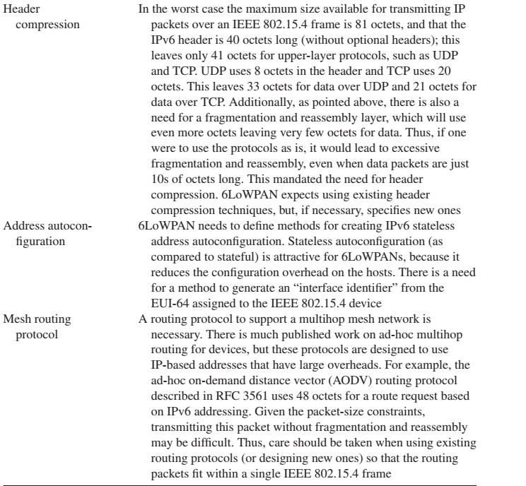
6LoWPAN in depth

Slide 72
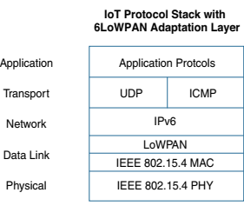
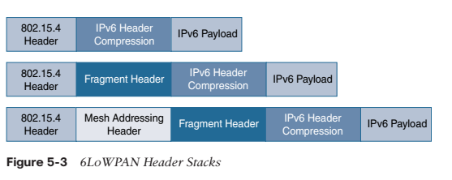
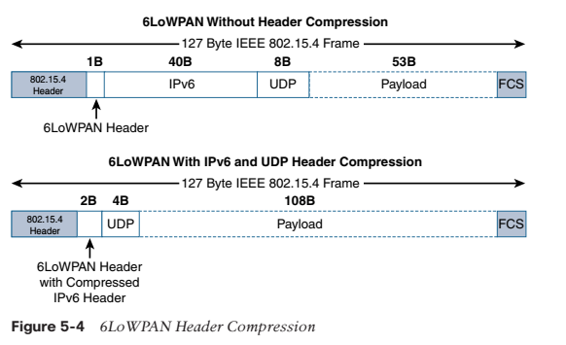
6LoWPAN in depth

Slide 73
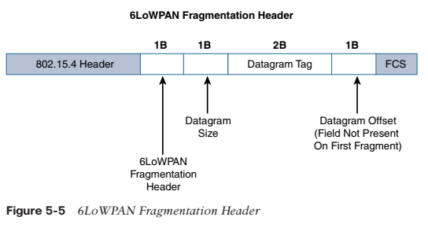
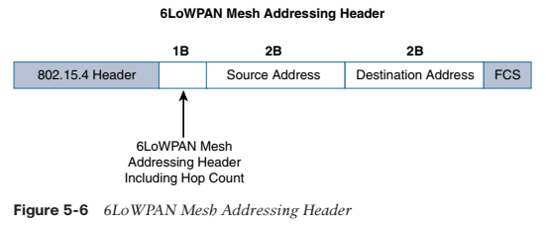
6LoWPAN in depth

Slide 74
6TiSCH
6TiSCH working group in IETF is developing standards to allow IPv6 to pass through Time-Slotted Channel Hopping (TSCH) mode of IEEE 802.15.4e datalinks.
It defines a Channel Distribution usage matrix consisting of available frequencies in columns and time-slots available for network scheduling operations in rows. This matrix is portioned into chucks where each chunk contains time and frequencies and is globally known to all nodes in the network.
The nodes within the same interference domain negotiate their scheduling so that each node gets to transmit in a chunk within its interference domain. Scheduling becomes an optimization problem where time slots are assigned to a group of neighboring nodes sharing the same application.
The standard does not specify how the scheduling can be done and leaves that to be an application specific problem in order to allow for maximum flexibility for different IoT applications. The scheduling can be centralized or distributed depending on application or the topology used in the MAC layer.

Slide 75
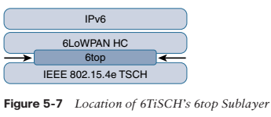
6TiSCH
The functionalities including network layer routing decisions, configuration, and control procedures for 6TiSCH schedule management.
The IEEE 802.15.4e standard defines a time slot structure, but it does not mandate a scheduling algorithm for how the time slots are utilized. This is left to higher-level protocols like 6TiSCH. Scheduling is critical because it can affect throughput, latency, and power consumption.
Schedules in 6TiSCH are broken down into cells. A cell is simply a single element in the TSCH schedule that can be allocated for unidirectional or bidirectional communications between specific nodes. Nodes only transmit when the schedule dictates that their cell is open for communication.

Slide 76
6TiSCH
The 6TiSCH architecture defines four schedule management mechanisms:
■ Static scheduling: All nodes in the constrained network share a fixed schedule. Cells are shared, and nodes contend for slot access in a slotted aloha manner. Slotted aloha is a basic protocol for sending data using time slot boundaries when communicating over a shared medium. Static scheduling is a simple scheduling mechanism that can be used upon initial implementation or as a fallback in the case of network malfunction. The drawback with static scheduling is that nodes may expect a packet at any cell in the schedule. Therefore, energy is wasted idly listening across all cells.
■ Neighbor-to-neighbor scheduling: A schedule is established that correlates with the observed number of transmissions between nodes. Cells in this schedule can be added or deleted as traffic requirements and bandwidth needs change.
■ Remote monitoring and scheduling management: Time slots and other resource allocation are handled by a management entity that can be multiple hops away. The scheduling mechanism leverages 6top and even CoAP in some scenarios. This scheduling mechanism provides quite a bit of flexibility and control in allocating cells for communication between nodes.
■ Hop-by-hop scheduling: A node reserves a path to a destination node multiple hops away by requesting the allocation of cells in a schedule at each intermediate node hop in the path. The protocol that is used by a node to trigger this scheduling mechanism is not defined at this point.

Slide 77
6TiSCH
There are three 6TiSCH forwarding models:
■ Track Forwarding (TF): This is the simplest and fastest forwarding model. A “track” in this model is a unidirectional path between a source and a destination.
■ Fragment forwarding (FF): This model takes advantage of 6LoWPAN fragmentation to build a Layer 2 forwarding table. Fragmentation within the 6LoWPAN protocol is covered earlier in this chapter, in the section “Fragmentation.”
■ IPv6 Forwarding (6F): This model forwards traffic based on its IPv6 routing table. Flows of packets should be prioritized by traditional QoS (quality of service) and RED (random early detection) operations.
For many IoT wireless networks, it is not necessary to be able to control the latency and throughput for sensor data. However, when some sort of determinism is needed, 6TiSCH provides an open, IPv6-based standard solution for ensuring predictable communications over wireless sensor networks.

Slide 78
ND
The Neighbor Discovery Protocol (NDP, ND) is a protocol in the Internet protocol suite used with Internet Protocol Version 6 (IPv6). It operates at the link layer of the Internet model (RFC 1122), and is responsible for gathering various information required for internet communication, including the configuration of local connections and the domain name servers and gateways used to communicate with more distant systems.
The protocol defines five different ICMPv6 packet types to perform functions for IPv6 similar to the Address Resolution Protocol (ARP) and Internet Control Message Protocol (ICMP) Router Discovery and Router Redirect protocols for IPv4. However, it provides many improvements over its IPv4 counterparts.
For example, it includes Neighbor Unreachability Detection (NUD), thus improving robustness of packet delivery in the presence of failing routers or links, or mobile nodes.

Slide 79
ND
NDP defines five ICMPv6 packet types for the purpose of router solicitation, router advertisement, neighbor solicitation, neighbor advertisement, and network redirects.
Router Solicitation: Hosts inquire with Router Solicitation messages to locate routers on an attached link. Routers which forward packets not addressed to them generate Router Advertisements immediately upon receipt of this message rather than at their next scheduled time.
Router Advertisement: Routers advertise their presence together with various link and Internet parameters either periodically, or in response to a Router Solicitation message.
Neighbor Solicitation: Neighbor solicitations are used by nodes to determine the link layer address of a neighbor, or to verify that a neighbor is still reachable via a cached link layer address.
Neighbor Advertisement: Neighbor advertisements are used by nodes to respond to a Neighbor Solicitation message.
Redirect: Routers may inform hosts of a better first hop router for a destination.

Slide 80
ND
These messages are used to provide the following functionality:
Router discovery: hosts can locate routers residing on attached links.
Prefix discovery: hosts can discover address prefixes that are on-link for attached links.
Parameter discovery: hosts can find link parameters (e.g., MTU).
Address autoconfiguration: optional stateless configuration of addresses of network interfaces.
Address resolution: mapping between IP addresses and link-layer addresses.
Next-hop determination: hosts can find next-hop routers for a destination.
Neighbor unreachability detection (NUD): determine that a neighbor is no longer reachable on the link.
Duplicate address detection (DAD): nodes can check whether an address is already in use.
Recursive DNS Server (RDNSS) and DNS Search List (DNSSL) assignment via a router advertisement (RA) options.
Packet redirection to provide a better next-hop route for certain destinations.

Slide 81
DHCP
Dynamic Host Configuration Protocol (DHCP) is a communications protocol enabling network administrators manage centrally and to automate the assignment of IP addresses in a network. In an IP network, each device connecting to the Internet needs a unique IP address.
DHCP lets a network administrator supervise and distribute IP addresses from a central point and automatically sends a new IP address when a computer is plugged into a different place in the network.
DHCP uses the concept of a “lease” or amount of time that a given IP address will be valid for a computer. The lease time can vary depending on how long a user is likely to require the Internet connection at a particular location. It’s especially useful in education and other environments where users change frequently. Using very short leases, DHCP can dynamically reconfigure networks in which there are more computers than there are available IP addresses. DHCP supports static addresses for computers containing Web servers that need a permanent IP address.
DHCP is an alternative to another network IP management protocol, Bootstrap Protocol (BOOTP). DHCP is a more advanced protocol but both configuration management protocols are commonly used. Some operating systems, including Windows NT/2000, come with DHCP servers. A DHCP or BOOTP client is a program that is located in each computer so that it can be configured.

Slide 82
ICMP
Internet Control Message Protocol (ICMP) is an integrated part of the IP suite. ICMP messages, delivered in IP packets, are used for out-of-band messages related to network operation or mis-operation. ICMP packet delivery is unreliable, so hosts can’t count on receiving ICMP packets for any network problems.
The key ICMP functions are:
Announce network errors, such as a host or entire portion of the network being unreachable, due to some type of failure. A TCP or UDP packet directed at a port number with no receiver attached is also reported via ICMP.
Announce network congestion. When a router begins buffering too many packets, due to an inability to transmit them as fast as they are being received, it will generate ICMP Source Quench messages. Directed at the sender, these messages should cause the rate of packet transmission to be slowed. Of course, generating too many Source Quench messages would cause even more network congestion, so they are used sparingly.
Assist Troubleshooting. ICMP supports an Echo function, which just sends a packet on a round--trip between two hosts. Ping, a common network management tool, is based on this feature. Ping will transmit a series of packets, measuring average round--trip times and computing loss percentages.

Slide 83
ICMP
Announce Timeouts. If an IP packet’s TTL field drops to zero, the router discarding the packet will often generate an ICMP packet announcing this fact. TraceRoute is a tool which maps network routes by sending packets with small TTL values and watching the ICMP timeout announcements.
The Internet Control Message Protocol (ICMP) was revised during the definition of IPv6. In addition, the multicast control functions of the IPv4 Group Membership Protocol (IGMP) are now incorporated in the ICMPv6.

Slide 84
RPL
Routing Protocol for Low-Power and Lossy Networks (RPL) is distance-vector protocol that can support a variety of datalink protocols, including the ones discussed in the previous section.
It builds a Destination Oriented Directed Acyclic Graph (DODAG) that has only one route from each leaf node to the root in which all the traffic from the node will be routed to. At first, each node sends a DODAG Information Object (DIO) advertising itself as the root. This message is propagated in the network and the whole DODAG is gradually built.
When communicating, the node sends a Destination Advertisement Object (DAO) to its parents, the DAO is propagated to the root and the root decides where to send it depending on the destination.
When a new node wants to join the network, it sends a DODAG Information Solicitation (DIS) request to join the network and the root will reply back with a DAO Acknowledgment (DAO-ACK) confirming the join. RPL nodes can be stateless, which is most common, or stateful. A stateless node keeps tracks of its parents only. Only root has the complete knowledge of the entire DODAG.
Hence, all communications go through the root in every case. A stateful node keeps track of its children and parents and hence when communicating inside a sub-tree of the DODAG, it does not have to go through the root.

Slide 85
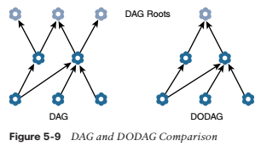
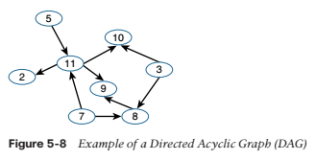
RPL
To cope with the constraints of computing and memory that are common characteristics of constrained nodes, the protocol defines two modes:
■ Storing mode: All nodes contain the full routing table of the RPL domain. Every node knows how to directly reach every other node.
■ Non-storing mode: Only the border router(s) of the RPL domain contain(s) the full routing table. All other nodes in the domain only maintain their list of parents and use this as a list of default routes toward the border router

Slide 86
RPL Metrics
RPL defines a large and flexible set of new metrics and constraints for routing in RFC 6551.
■ Expected Transmission Count (ETX): Assigns a discrete value to the number of transmissions a node expects to make to deliver a packet.
■ Hop Count: Tracks the number of nodes traversed in a path. Typically, a path with a lower hop count is chosen over a path with a higher hop count.
■ Latency: Varies depending on power conservation. Paths with a lower latency are preferred.
■ Link Quality Level: Measures the reliability of a link by taking into account packet error rates caused by factors such as signal attenuation and interference.
■ Link Color: Allows manual influence of routing by administratively setting values to make a link more or less desirable. These values can be either statically or dynamically adjusted for specific traffic types.
■ Node State and Attribute: Identifies nodes that function as traffic aggregators and nodes that are being impacted by high workloads. High workloads could be indicative of nodes that have incurred high CPU or low memory states. Naturally, nodes that are aggregators are preferred over nodes experiencing high workloads.
■ Node Energy: Avoids nodes with low power, so a battery-powered node that is running out of energy can be avoided and the life of that node and the network can be prolonged.
■ Throughput: Provides the amount of throughput for a node link. Often, nodes conserving power use lower throughput. This metric allows the prioritization of paths with higher throughput.

Slide 87
CORPL
An extension of RPL is CORPL, or cognitive RPL, which is designed for cognitive networks and uses DODAG topology generation but with two new modifications to RPL.
CORPL utilizes opportunistic forwarding to forward the packet by choosing multiple forwarders (forwarder set) and coordinates between the nodes to choose the best next hop to forward the packet to. DODAG is built in the same way as RPL.
Each node maintains a forwarding set instead of its parent only and updates its neighbor with its changes using DIO messages. Based on the updated information, each node dynamically updates its neighbor priorities in order to construct the forwarder set.

Slide 88
CARP
Channel-Aware Routing Protocol (CARP) is a distributed routing protocol designed for underwater communication. It can be used for IoT due to its lightweight packets. It considers link quality, which is computed based on historical successful data transmission gathered from neighboring sensors, to select the forwarding nodes.
There are two scenarios: network initialization and data forwarding. In network initialization, a HELLO packet is broadcasted from the sink to all other nodes in the networks. In data forwarding, the packet is routed from sensor to sink in a hop- by-hop fashion. Each next hop is determined independently.
The main problem with CARP is that it does not support reusability of previously collected data. In other words, if the application requires sensor data only when it changes significantly, then CARP data forwarding is not beneficial to that specific application. An enhancement of CARP was done in E-CARP by allowing the sink node to save previously received sensory data. When new data is needed, E-CARP sends a Ping packet which is replied with the data from the sensors nodes. Thus, E-CARP reduces the communication overhead drastically.

